Slide 1

NPTEL
Applied Accelerated Artificial Intelligence
Instructor: Dr. Satyajit Das
Dept. of Computer Science and Engineering
Indian Institute of Technology Guwahati, Assam, India

Slide 2
Segment 2: Building Neural Networks with nn.Module
From raw matrix multiplications to well-organised, inspectable, saveable neural network models

Slide 3
Learning Objectives — Segment 2
01
Explain why torch.nn.Module is the fundamental building block and what it provides over raw tensor operations
02
Define a custom neural network by subclassing nn.Module and implementing __init__ and forward methods
03
Use built-in layers: nn.Linear, nn.Conv2d, nn.BatchNorm2d, nn.LayerNorm, nn.Dropout, nn.Embedding
04
Inspect a model's parameters, named_modules, and compute total parameter count
05
Save and load model weights using state_dict, torch.save, and torch.load

Slide 4
torch.nn.Module: The Building Block of All Models
What nn.Module Provides Automatically
Parameter registration: anything assigned as nn.Parameter or nn.Module is tracked
model.parameters(): iterator over all learnable weights across all sub-modules
model.to(device): recursively moves all parameters and buffers to device
model.train() / model.eval(): set training mode (affects Dropout, BatchNorm)
model.state_dict(): ordered dict of all parameter tensors — for saving/loading
nn.Parameter vs Buffers
nn.Parameter: a tensor that IS a learnable weight — appears in parameters()
self.register_buffer('running_mean', torch.zeros(C)): a tensor that is NOT a weight but is saved with the model (e.g. BatchNorm statistics)
Buffers move with .to(device) but are not optimised
Calling the Module
layer(x) calls __call__ which calls forward — NEVER call layer.forward(x) directly
__call__ adds hooks, checks, and other functionality around forward
Why Not Just Use Tensors?
Raw tensors: you must manually track weights, move them to GPU, save them, load them
nn.Module automates all of this: it is a container that organises parameters, sub-modules, and the forward computation
Composable: any nn.Module can contain other nn.Modules — entire model trees, not just layers
The Two Required Components
import torch
import torch.nn as nn
class MyLayer(nn.Module):
def __init__(self):
super().__init__() # ALWAYS call this
self.linear = nn.Linear(4, 3) # creates W and b
self.relu = nn.ReLU()
def forward(self, x):
x = self.linear(x) # calls linear.forward(x)
return self.relu(x)
layer = MyLayer()
out = layer(torch.randn(2, 4)) # calls layer.forward()
Ref: PyTorch nn.Module Documentation (pytorch.org/docs/stable/generated/torch.nn.Module.html)

Slide 5
Built-in Layers: The Vocabulary of Neural Network Design
Linear Layers
nn.Linear(in_features, out_features, bias=True): fully connected layer — computes Wx + b
Weights initialised with Kaiming uniform by default (designed for ReLU networks)
nn.LazyLinear: infers in_features on first forward call — convenient for prototyping
Convolutional Layers
nn.Conv2d(in_ch, out_ch, kernel_size, stride=1, padding=0): 2D convolution for images
nn.Conv1d: for sequences (1D signals, text representations)
nn.ConvTranspose2d: transposed convolution (upsampling in generative models)
padding='same': pads input so output has same spatial size as input (PyTorch 1.9+)
Normalisation Layers — Critical for Deep Networks
nn.BatchNorm2d(C): normalises across the batch; has learnable scale (gamma) and shift (beta); uses running statistics at inference
nn.LayerNorm(normalised_shape): normalises across the features of each sample; used in Transformers; works with any batch size
nn.GroupNorm(num_groups, num_channels): compromise between Batch and Layer norm; used in object detection
nn.RMSNorm (PyTorch 2.4+): simplified LayerNorm without mean subtraction; used in Llama, Mistral
Activation Functions
nn.ReLU(): max(0, x) — still common in CNNs
nn.GELU(): Gaussian Error Linear Unit — standard in Transformers (GPT, BERT)
nn.SiLU() / Swish: used in modern LLMs (Llama 2, Phi)
nn.Sigmoid(), nn.Tanh(): use in gates and output layers for probabilities
Regularisation and Sequence Layers
nn.Dropout(p=0.1): randomly zeros p fraction of activations during training; becomes identity at eval
nn.Embedding(num_embeddings, embedding_dim): lookup table; converts integer token IDs to dense vectors
nn.MultiheadAttention(embed_dim, num_heads): full multi-head attention with optional causal masking
nn.TransformerEncoderLayer: complete Pre-LN or Post-LN Transformer block with attention + FFN + norms
Ref: PyTorch nn Module Reference (pytorch.org/docs/stable/nn.html)

Slide 6
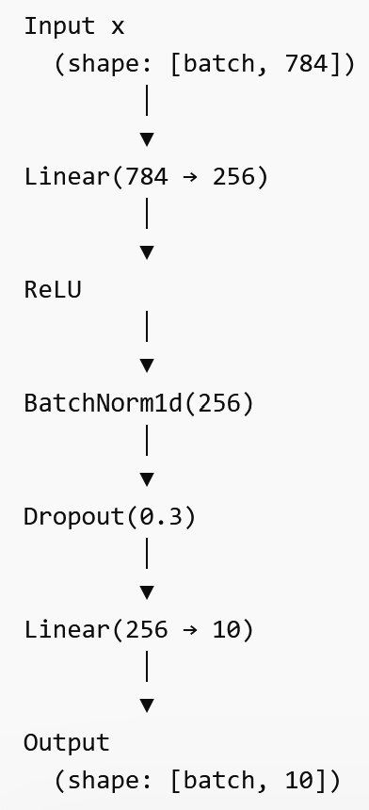
Composing Models with nn.Sequential and Custom Architectures
nn.Sequential: Quick Composition for Simple Networks
model = nn.Sequential(
nn.Linear(784, 256),
nn.ReLU(),
nn.BatchNorm1d(256),
nn.Dropout(0.3),
nn.Linear(256, 10),
)
Modules executed in order; input of each = output of previous
Limitation: cannot branch, merge, or skip connections
Ref: PyTorch Save/Load Tutorial (pytorch.org/tutorials/beginner/saving_loading_models.html)

Slide 7
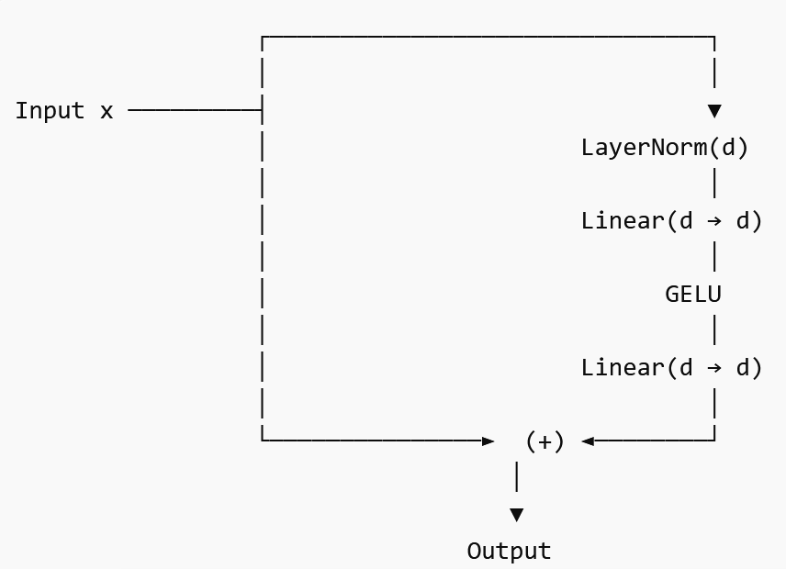
Composing Models with nn.Sequential and Custom Architectures
Custom Architecture with Skip Connections
class ResBlock(nn.Module):
def __init__(self, d):
super().__init__()
self.net = nn.Sequential(
nn.LayerNorm(d),
nn.Linear(d, d),
nn.GELU(),
nn.Linear(d, d),
)
def forward(self, x):
return x + self.net(x) # residual connection
Ref: PyTorch Save/Load Tutorial (pytorch.org/tutorials/beginner/saving_loading_models.html)

Slide 8
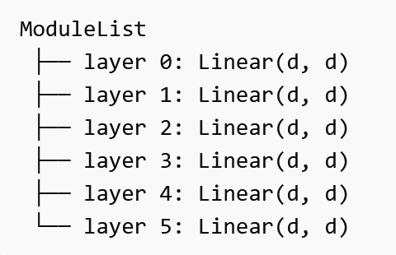
Composing Models with nn.Sequential and Custom Architectures
nn.ModuleList: Dynamic Lists of Modules
self.layers = nn.ModuleList([
nn.Linear(d, d) for _ in range(6)
])
Unlike Python list: modules in ModuleList are tracked by PyTorch
Sequential:- automatic straight-line execution- easiest for simple networks- cannot do skip/branch/merge logicCustom
Module:- you write forward() yourself- can do residual connections, branching, merging
ModuleList:- stores many layers properly- PyTorch tracks them- useful for loops and dynamic architectures- does not automatically define execution order like Sequential
Ref: PyTorch Save/Load Tutorial (pytorch.org/tutorials/beginner/saving_loading_models.html)

Slide 9
Composing Models with nn.Sequential and Custom Architectures
Saving and Loading Model Weights
# Save weights only (recommended)
torch.save(model.state_dict(), 'model.pth')
# Load weights into a new model instance
model2 = MyModel()
model2.load_state_dict(torch.load('model.pth'))
Always save state_dict, never the entire model object
Entire model pickle embeds the class definition — breaks when code changes
state_dict is just a dict of tensors — portable and version-stable
Inspecting Models
model = MyModel()
# Total parameter count
total = sum(p.numel() for p in model.parameters())
trainable = sum(p.numel() for p in model.parameters()
if p.requires_grad)
print(f'{total/1e6:.1f}M params, {trainable/1e6:.1f}M trainable')
# Named parameter shapes
for name, p in model.named_parameters():
print(name, p.shape)
# Module tree
print(model)
Ref: PyTorch Save/Load Tutorial (pytorch.org/tutorials/beginner/saving_loading_models.html)

Slide 10
Defining a Complete Model: A Worked Example
A Complete 3-Layer MLP Classifier
class MLPClassifier(nn.Module):
def __init__(self, input_dim, hidden_dim,
output_dim, dropout=0.1):
super().__init__()
self.net = nn.Sequential(
nn.Linear(input_dim, hidden_dim),
nn.LayerNorm(hidden_dim),
nn.GELU(),
nn.Dropout(dropout),
nn.Linear(hidden_dim, hidden_dim),
nn.LayerNorm(hidden_dim),
nn.GELU(),
nn.Dropout(dropout),
nn.Linear(hidden_dim, output_dim),
)
def forward(self, x):
return self.net(x)
model = MLPClassifier(784, 512, 10).to('cuda')
print(model) # shows full architecture
# 784->512->512->10 = ~800K parameters
A Mini Transformer for Text Classification
class TextClassifier(nn.Module):
def __init__(self, vocab, d=128, h=4, layers=2):
super().__init__()
self.embed = nn.Embedding(vocab, d)
self.layers = nn.ModuleList([
nn.TransformerEncoderLayer(
d_model=d, nhead=h,
dim_feedforward=d*4,
batch_first=True,
norm_first=True,
) for _ in range(layers)
])
self.head = nn.Linear(d, 2) # binary
def forward(self, token_ids):
x = self.embed(token_ids) # (B,T,d)
for layer in self.layers:
x = layer(x)
return self.head(x.mean(1)) # pool over T
Weight Initialisation
PyTorch default: Kaiming uniform for Linear and Conv (good for ReLU/GELU)
Custom init: model.apply(init_fn) applies a function to every sub-module
def init_weights(m):
if isinstance(m, nn.Linear):
nn.init.xavier_uniform_(m.weight)
nn.init.zeros_(m.bias)
model.apply(init_weights)
Ref: Glorot & Bengio, Understanding Difficulty of Training Deep Feedforward Networks, AISTATS 2010

Slide 11
Segment 2 Summary: Building Models with nn.Module
nn.Module is the fundamental building block: it automatically tracks parameters, enables .to(device), and provides train/eval mode switching — never use raw tensors for weights
Implement __init__ to define layers and forward to define computation. Always call super().__init__(). Call the model like a function: model(x) — never model.forward(x)
Essential layers: nn.Linear (MLP), nn.Conv2d (vision), nn.LayerNorm + nn.MultiheadAttention (Transformers), nn.Embedding (NLP), nn.Dropout (regularisation)
Inspect models with model.parameters() for optimisation, named_parameters() for debugging, model.state_dict() for saving/loading
Always save and load state_dict, never the entire model object — it is just a dict of tensors and remains portable across code changes and PyTorch versions

Slide 12
Thank you!

